Slide 1
Blendenpik: Supercharging LAPACK'S Least-Squares Solver
Brandon, Jacob, Adam

Slide 2
The Paper
Blendenpik: Supercharging LAPACK'S Least-Squares Solver
Authors:
Haim Avron, Petar Maymounkov, Sivan Toledo
SIAM Journal on Scientific Computing, Vol. 32, No. 3, 2010

Slide 3
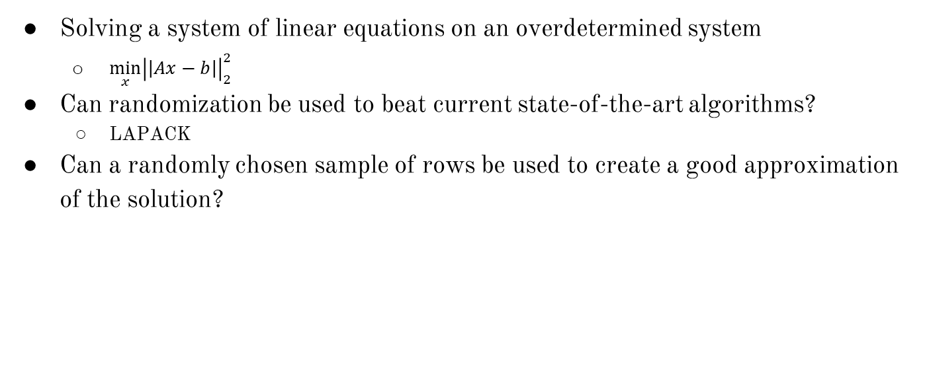
The Problem

Slide 4
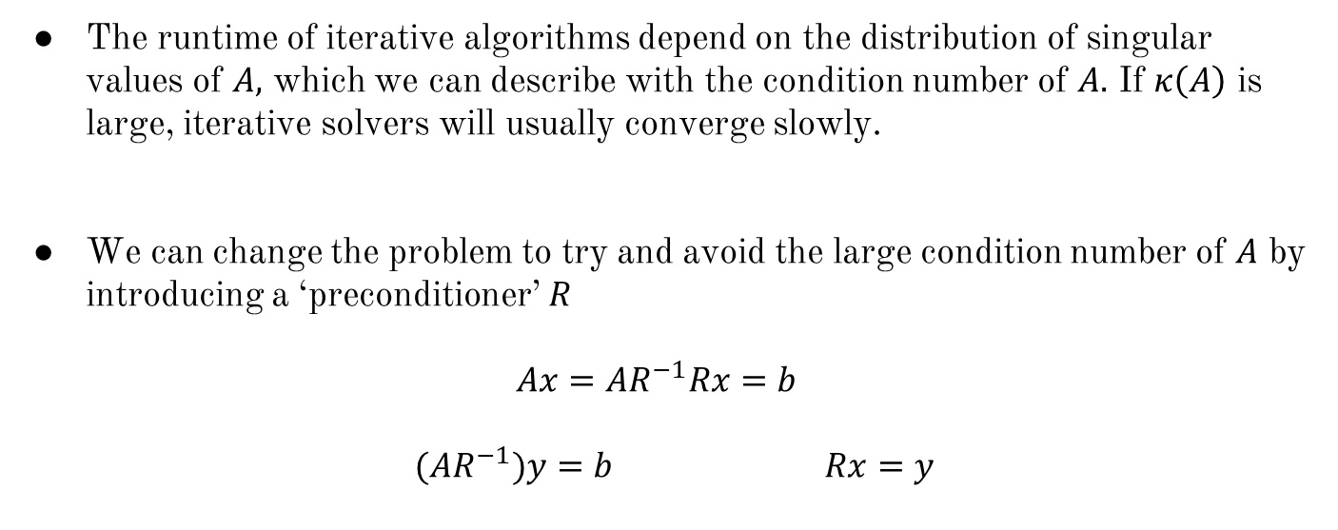
Ideas for a Least Squares Solver
Notes:
1

Slide 5
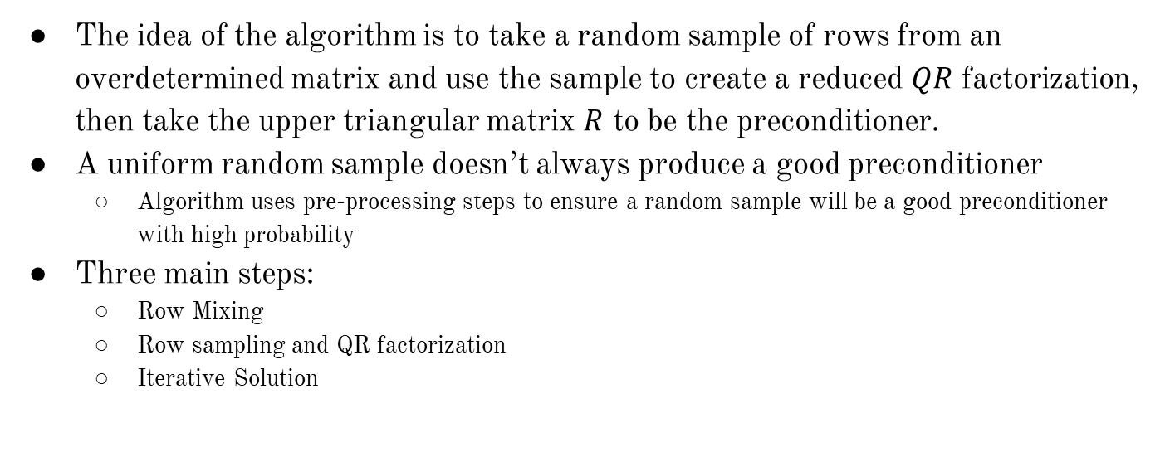
The Algorithm

Slide 6
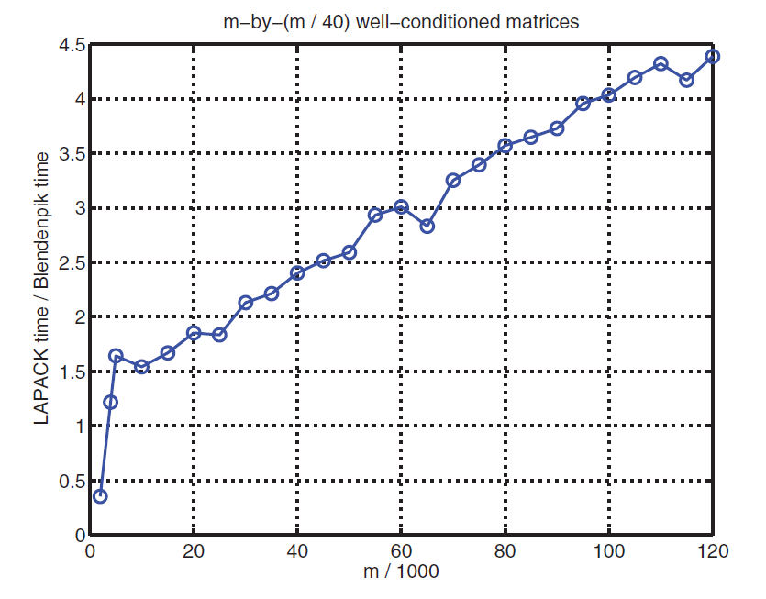
The Result
Blendenpik beats LAPACK on any tall, dense matrix
Blendenpik is slower on tiny matrices, nearly square matrices, and some sparse matrices
Blendenpik is numerically-backwards stable
Achieves residuals similar to direct QR factorization-based solvers
Scales significantly better than any other QR-based solver

Slide 7
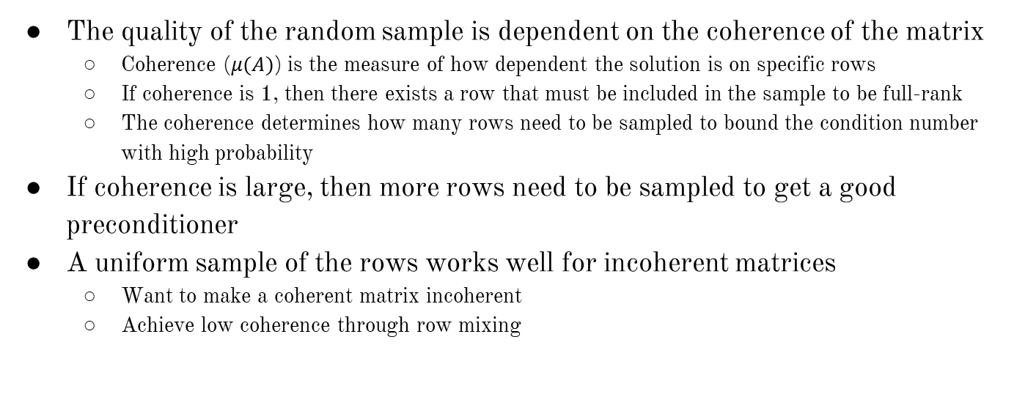
The Theory

Slide 8
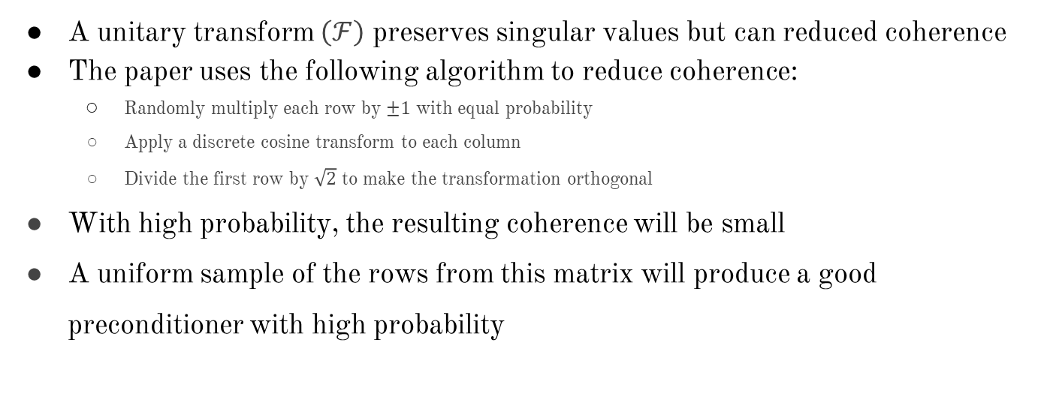
Row Mixing

Slide 9
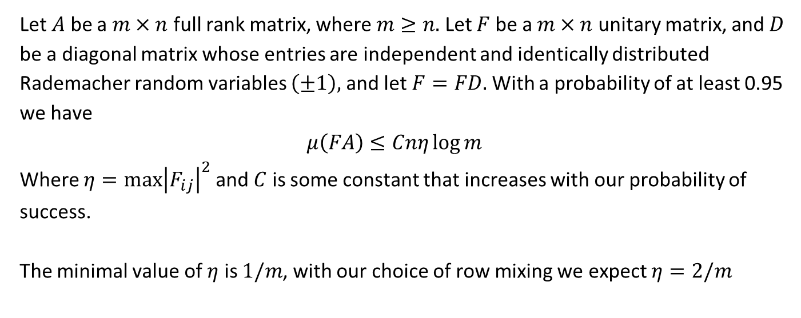
Row Mixing
Let $A$ be a $m×n$ full rank matrix, where $m≥n.$ Let $F$ be a $m×n$ unitary matrix, and $D$ be a diagonal matrix whose entries are independent and identically distributed Rademacher random variables $\left(±1\right),$ and let $F=FD.$ With a probability of at least 0.95 we have
$$μ\left(FA\right)≤Cnη\log{m}$$
Where $η={\max\left|F_{ij}\right|}^{2}$ and $C$ is some constant that increases with our probability of success.
The minimal value of $η$ is $1/m$, with our choice of row mixing we expect $η=2/m$

Slide 10
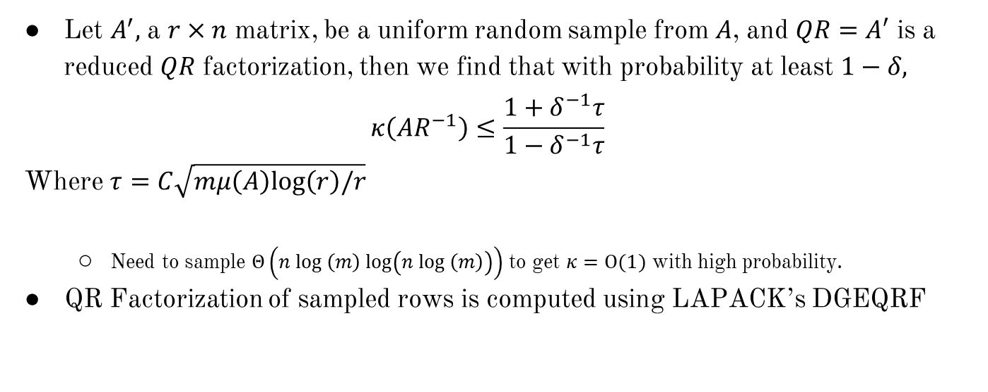
Row Sampling and QR Factorization
Notes:
1

Slide 11
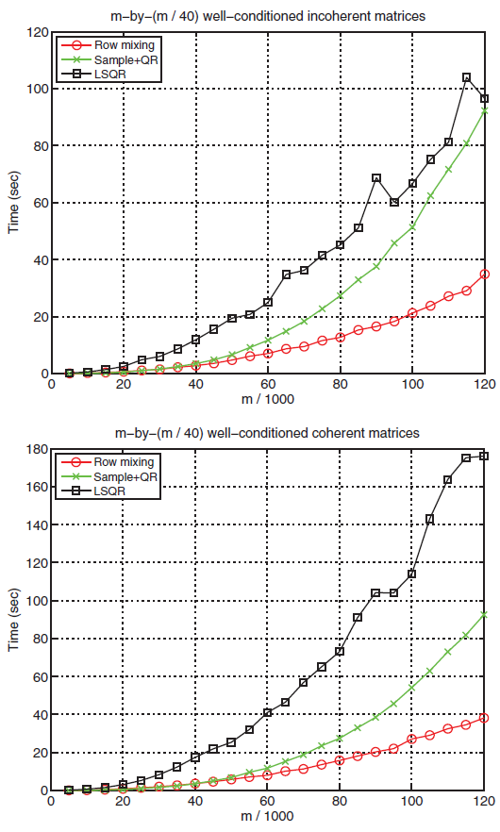
The Cost
Row Mixing
Θ(mn log m)
Row Sampling and QR Factorization
Θ(n³)
Iterative Solution
Most costly phase of algorithm
Each iteration is Θ(mn)
Number of iterations grows slowly

Slide 12
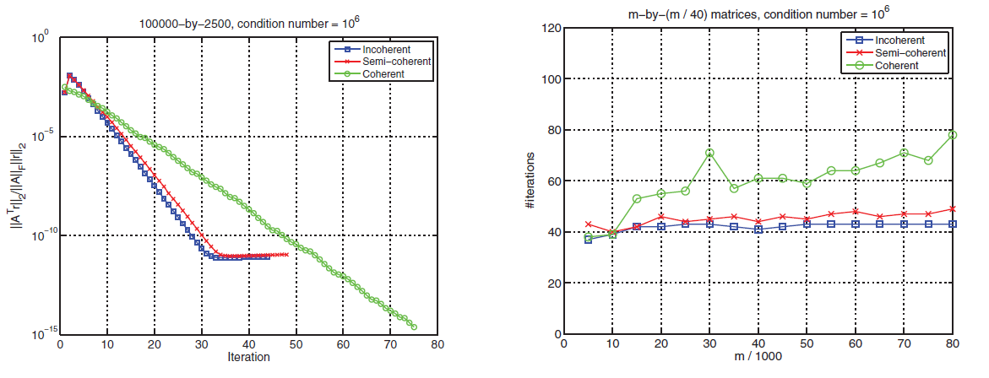
Iterative Solution
LSQR is used on the sampled rows to approximate the solution
This algorithm is about as stable as a QR-based solver
Most of the running time is spent on multiplying vectors by A and A^{T}

Slide 13
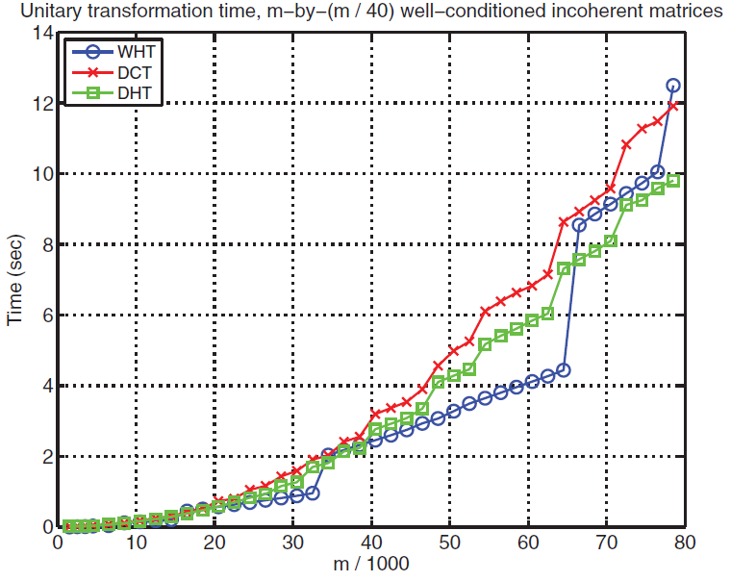
Different Unitary Transformations
Transformation used in the algorithm is the discrete cosine transform (DCT)
Other transformations are available:
Walsh-Hadamard transform (WHT)
Discrete Hartley transform (DHT)
WHT is the best in theory, but sometimes fails to mix rows well enough
DHT and DCT work better in practice and are easier to apply to arbitrary matrices

Slide 14
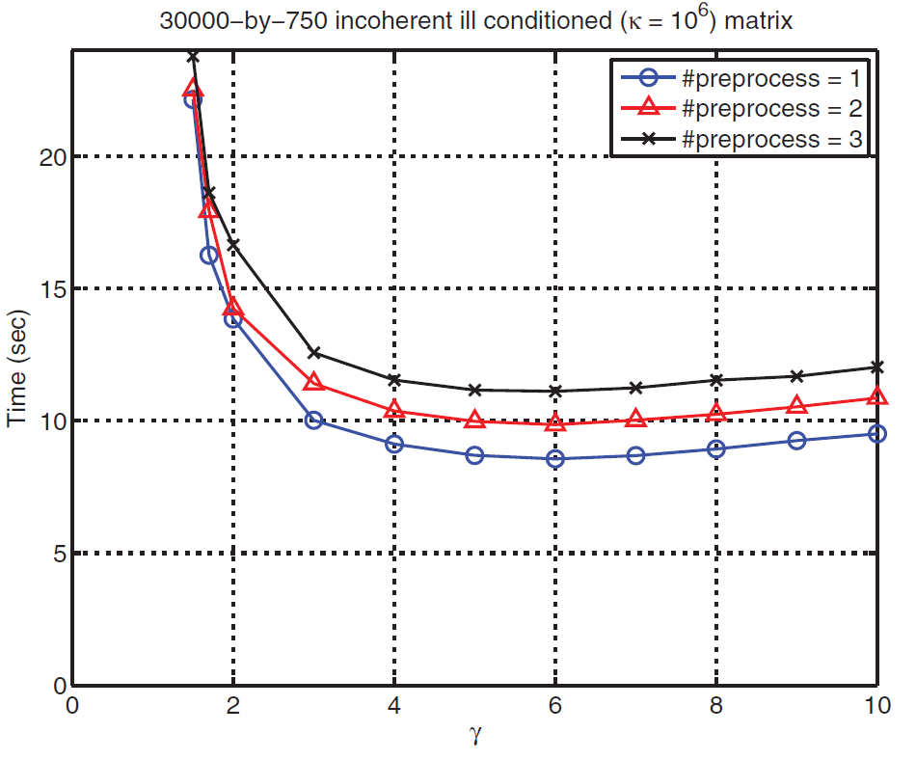
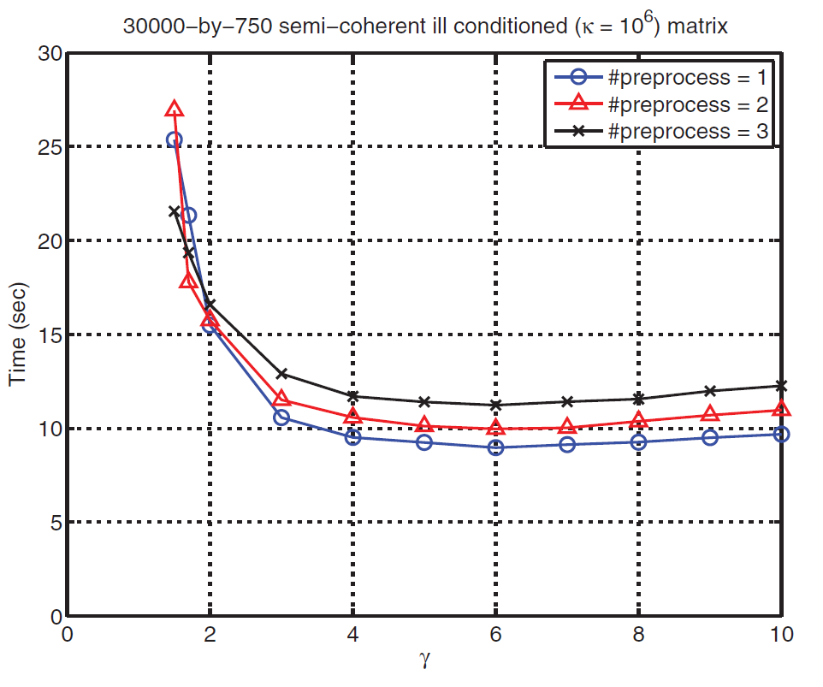
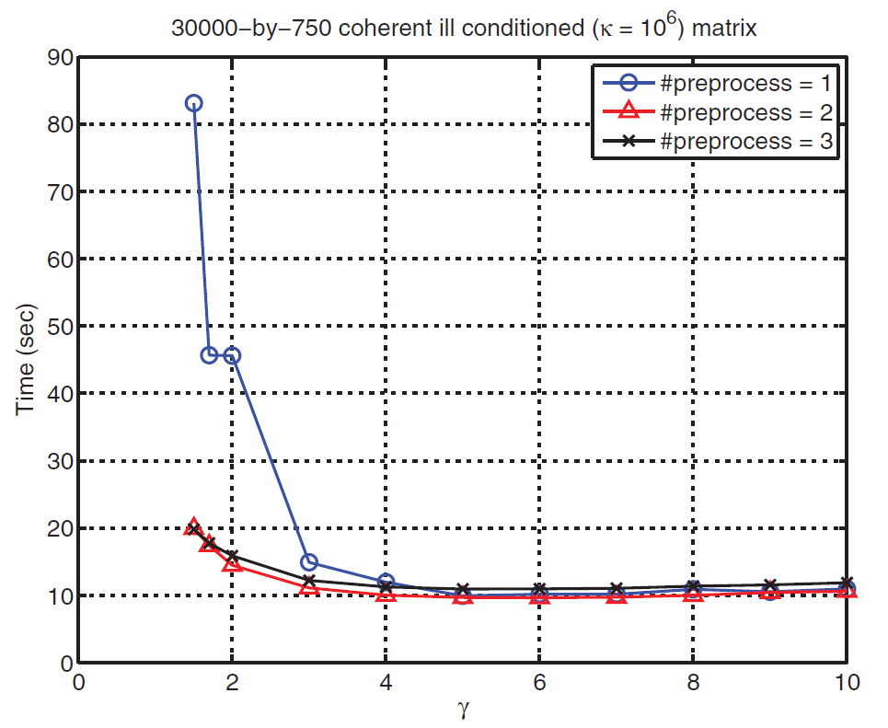
Row Mixing Evaluation
Larger sample size
Greater probability of getting a good preconditioner
Makes other parts of the algorithm take more time
Computation time was found to decrease, then increase as sample size increased

Slide 15
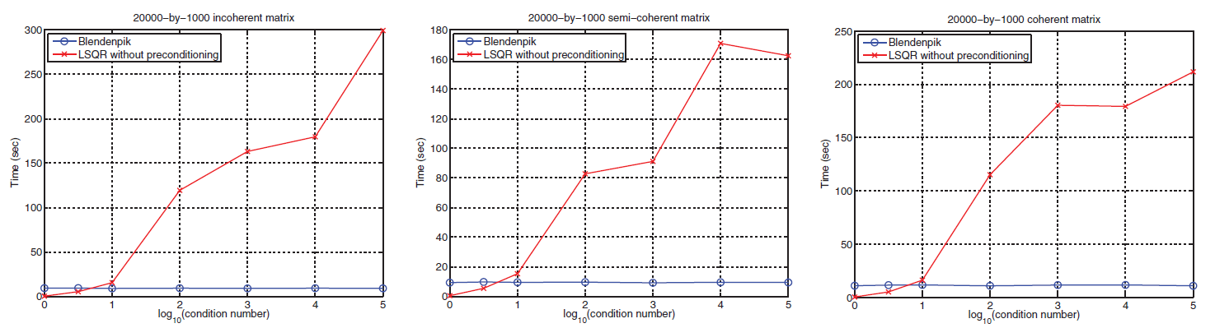
Ill-Conditioned Matrices
This algorithm beats the unpreconditioned LSQR for ill-conditioned matrices
The unpreconditioned LSQR beats Blendenpik for well conditioned matrices

Slide 16
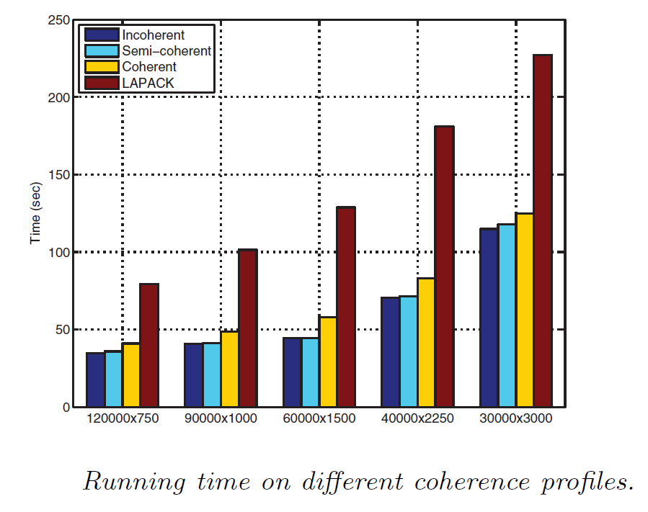
Coherence Evaluation
Algorithm runs longer on matrices with high coherence compared to matrices with low coherence
Blendenpik beast LAPACK in both cases

Slide 17
Comparison to Prior Algorithms
LAPACK
Blendenpik outperforms LAPACK on most matrices
Faster least squares approximation
Proposes a more sophisticated algorithm that leads to a small residual for any matrix
Small uniform sample does not work on any matrix
A fast randomized algorithm for overdetermined linear least-squares regression
Uses a uniform random sample of the rows
May not work in matrices with high coherence

Slide 18
Empirical Evaluation
25 runs of randomly generated sparse matrices
Each matrix with a random number of rows, m, between 10,000 and 20,000, number of columns, n, equal to m/40, and density randomly in [0,1)
Average Blendenpik time: 3.160 s
Average Numpy time: 17.026 s
Average Blendenpik residual: .00000070455
Average Numpy residual: .000000028423

